Slide 1
The Source of Life
2024 Quarter 4 Lesson 9
John 1, 6
The Desire of Ages Ch. 39 “Give Ye them to Eat”

Slide 2
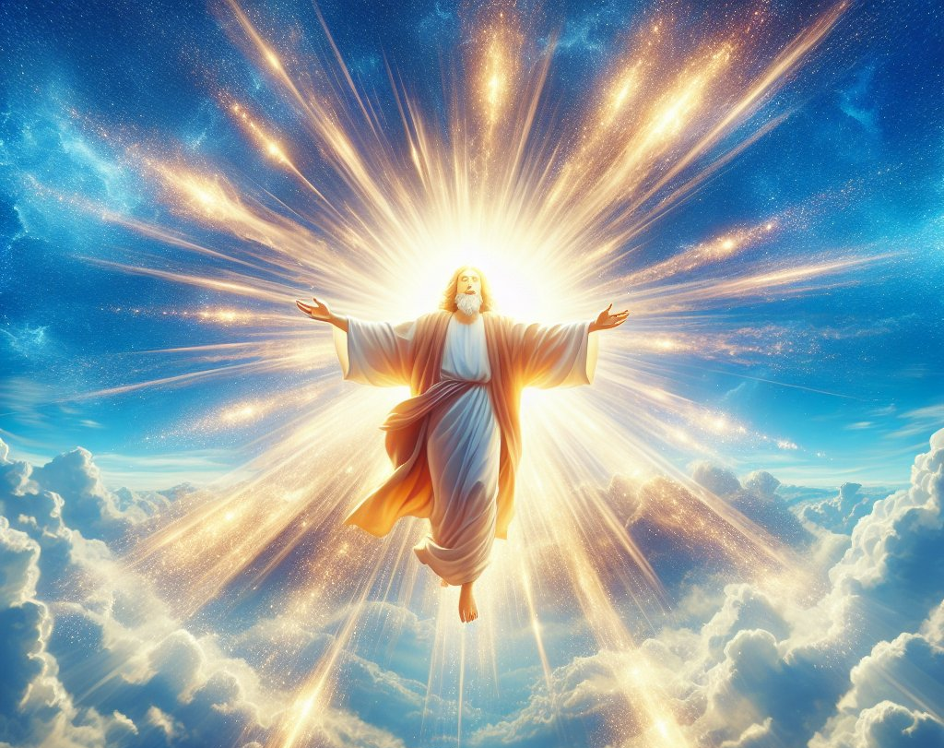
The Source of Light
John 1:1-14

Slide 3
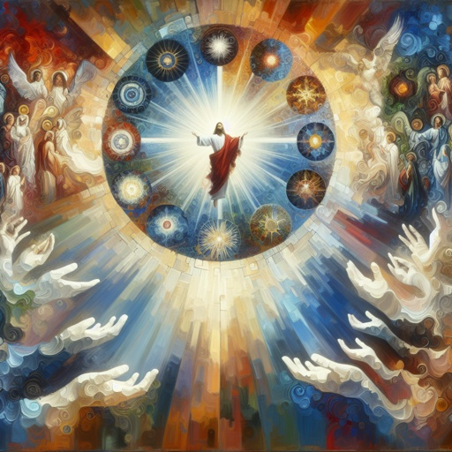
Life and Light - John 1:1-14
1 In the beginning was the Word, and the Word was with God, and the Word was God.

Slide 4
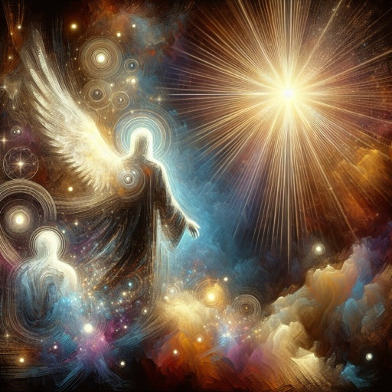
Life and Light - John 1:2-14
2 The same was in the beginning with God.

Slide 5

Life and Light - John 1:3-14
3 All things were made by him; and without him was not any thing made that was made.

Slide 6
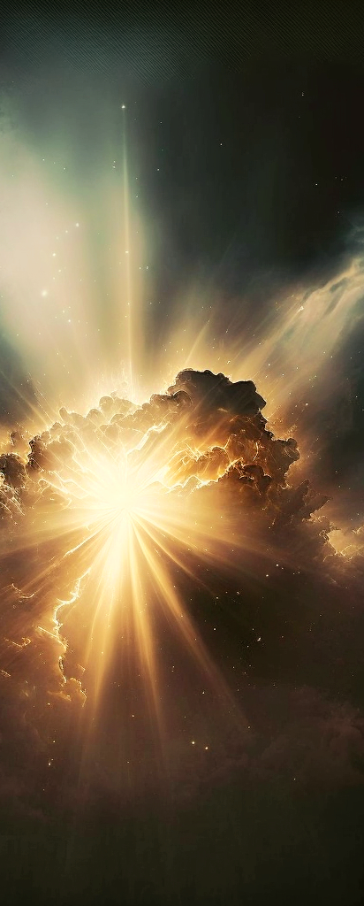
Life and Light- Genesis 1:1-3
1 In the beginning God created the heaven and the earth.
2 And the earth was without form, and void; and darkness was upon the face of the deep. And the Spirit of God moved upon the face of the waters.
3 And God said, Let there be light: and there was light.

Slide 7
As the first act of creation God flooded the world with light, so when God sets about the work of recreating His image in the souls of men He first illumines their hearts and minds with the light of divine love (2 Cor. 4:6). “With thee,” says the psalmist, “is the fountain of life: in thy light shall we see light” (Ps. 36:9).
SDABC on John 1:4

Slide 8
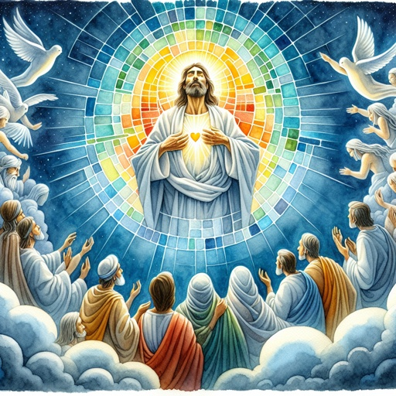
Life and Light - John 1:4-14
4 In him was life; and the life was the light of men.

Slide 9
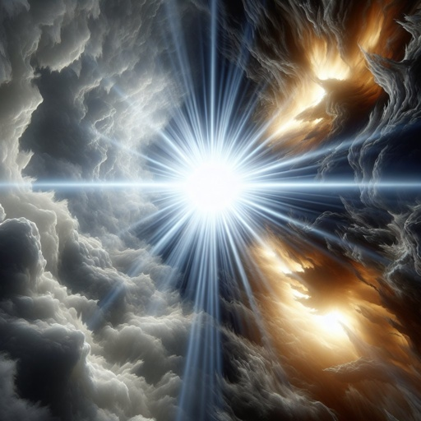
Life and Light - John 1:5-14
5 And the light shineth in darkness; and the darkness comprehended it not.

Slide 10
Through sin man separated himself from the source of life, and therefore became subject to death, but the prospect of eternal life was restored through Jesus Christ, and with it all that Adam lost through transgression. “In Christ is life, original, unborrowed, underived” (DA 530).
SDABC on John 1:4

Slide 11
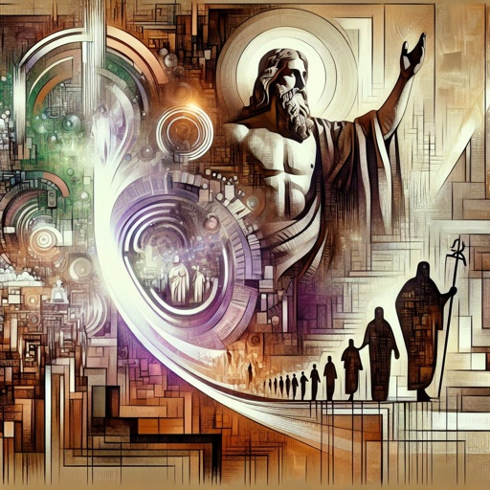
Life and Light - John 1:6-14
6 There was a man sent from God, whose name was John.

Slide 12
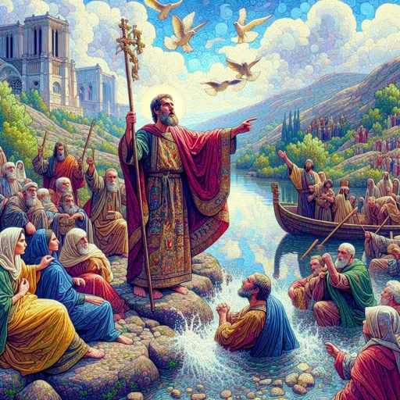
Life and Light - John 1:7-14
7 The same came for a witness, to bear witness of the Light, that all men through him might believe.

Slide 13
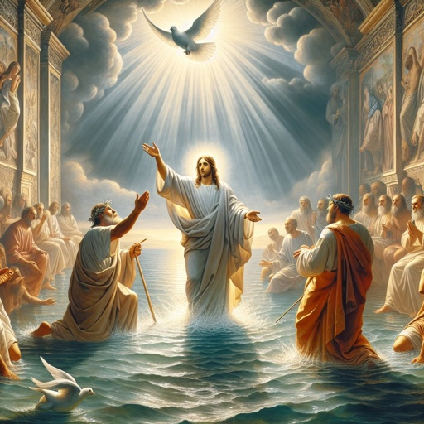
Life and Light - John 1:8-14
8 He was not that Light, but was sent to bear witness of that Light.

Slide 14
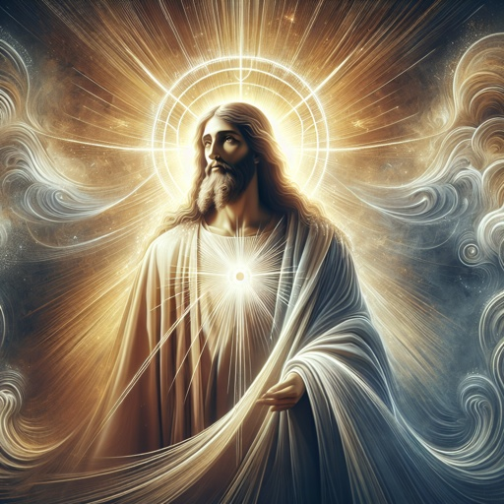
Life and Light - John 1:9-14
9 That was the true Light, which lighteth every man that cometh into the world.

Slide 15
Spiritual darkness had long shrouded men’s souls, but the “true Light” of divine life and perfection now shines forth to illumine the pathway of every man. Not only does the light of Heaven shine forth through Christ, He is that light. Again and again John quotes Jesus to this effect. Light has ever been a symbol of the divine presence.
SDABC on John 1:4

Slide 16
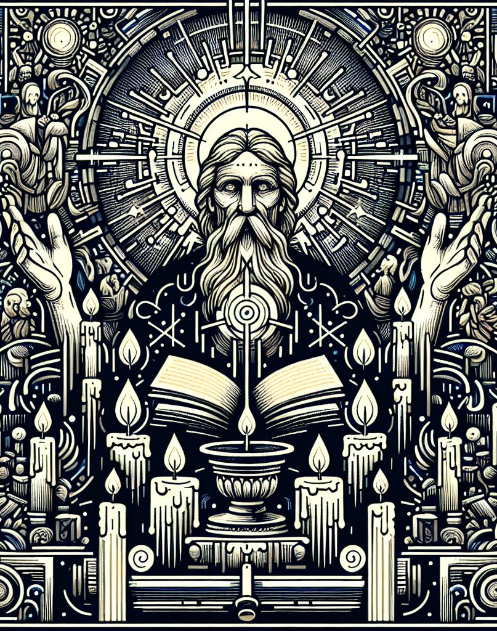
Life and Light- John 8:12
12 Then spake Jesus again unto them, saying, I am the light of the world: he that followeth me shall not walk in darkness, but shall have the light of life.

Slide 17
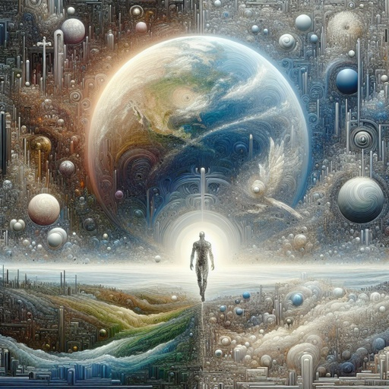
Life and Light - John 1:10-14
10 He was in the world, and the world was made by him, and the world knew him not.

Slide 18
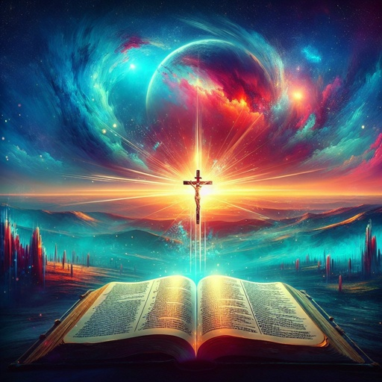
Life and Light - John 1:11-14
11 He came unto his own, and his own received him not.

Slide 19
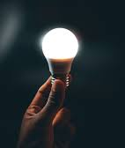
Life and Light- John 14:6
6 Jesus saith unto him, I am the way, the truth, and the life: no man cometh unto the Father, but by me.

Slide 20
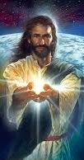
Life and Light- John 11:25-26
25 Jesus said unto her, I am the resurrection, and the life: he that believeth in me, though he were dead, yet shall he live:
26 And whosoever liveth and believeth in me shall never die. Believest thou this?

Slide 21
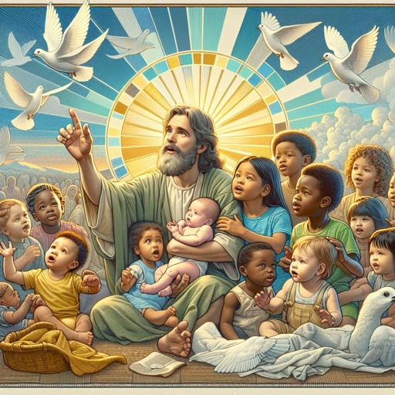
Life and Light - John 1:12-14
12 But as many as received him, to them gave he power to become the sons of God, even to them that believe on his name:

Slide 22
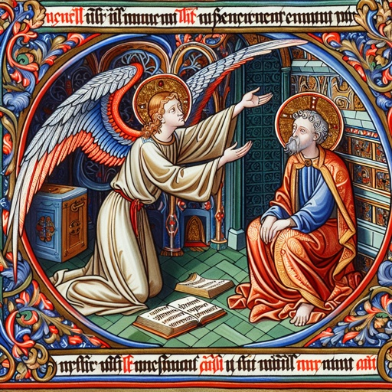
Life and Light - John 1:13-14
13 Which were born, not of blood, nor of the will of the flesh, nor of the will of man, but of God.

Slide 23
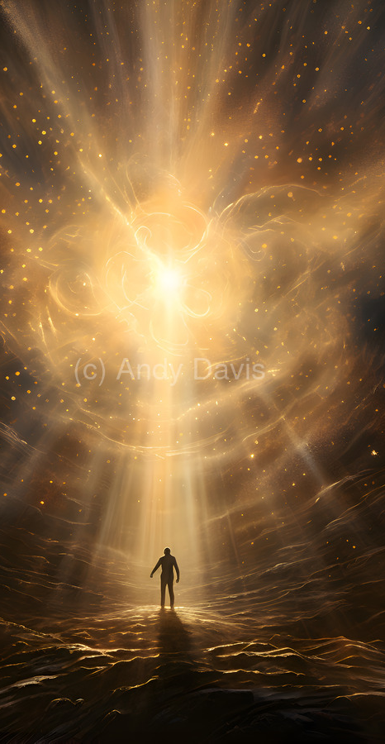
Life and Light- John 10:10
10 The thief cometh not, but for to steal, and to kill, and to destroy: I am come that they might have life, and that they might have it more abundantly.

Slide 24

Life and Light - John 1:14
14 And the Word was made flesh, and dwelt among us, (and we beheld his glory, the glory as of the only begotten of the Father,) full of grace and truth.

Slide 25
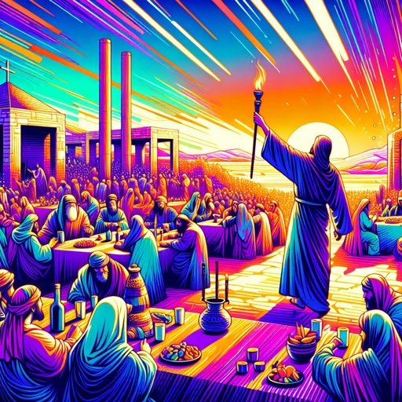
Life and Light- John 9:5
5 As long as I am in the world, I am the light of the world.

Slide 26
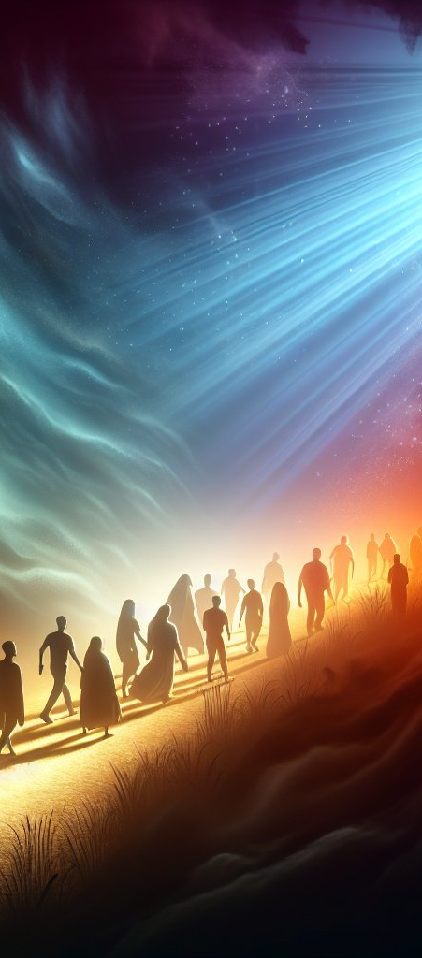
Life and Light- John 12:35-36
35 Then Jesus said unto them, Yet a little while is the light with you. Walk while ye have the light, lest darkness come upon you: for he that walketh in darkness knoweth not whither he goeth.
36 While ye have light, believe in the light, that ye may be the children of light. These things spake Jesus, and departed, and did hide himself from them.

Slide 27
The Source of Bread
John 6:1-13

Slide 28
Christ never worked a miracle except to supply a genuine necessity, and every miracle was of a character to lead the people to the tree of life, whose leaves are for the healing of the nations. The simple food passed round by the hands of the disciples contained a whole treasure of lessons.
The Desire of Ages, p. 366

Slide 29
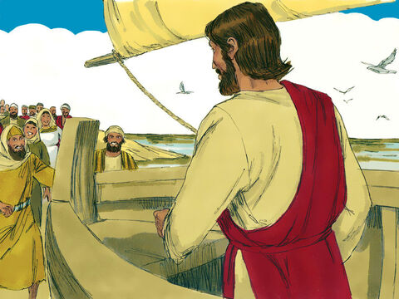
Miraculous Bread - John 6:1
After these things Jesus went over the sea of Galilee, which is the sea of Tiberias.

Slide 30
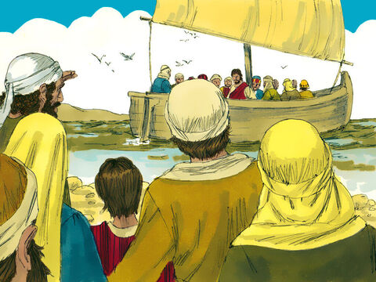
Miraculous Bread - John 6:2
And a great multitude followed him, because they saw his miracles which he did on them that were diseased.

Slide 31
He “was moved with compassion toward them, because they were as sheep not having a shepherd.” …They received no help from the priests and rulers; but the healing waters of life flowed from Christ as He taught the multitude the way of salvation.
The Desire of Ages, p. 364

Slide 32
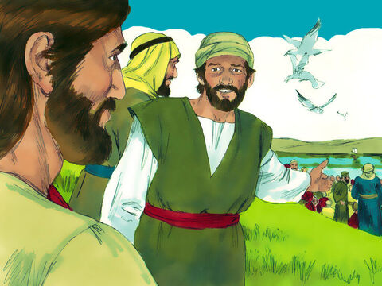
Miraculous Bread - John 6:3
And Jesus went up into a mountain, and there he sat with his disciples.

Slide 33
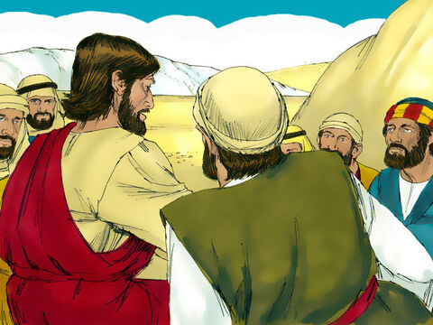
Miraculous Bread - John 6:4
And the passover, a feast of the Jews, was nigh.

Slide 34
The people listened to the words of mercy flowing so freely from the lips of the Son of God… The day seemed to them like heaven upon earth, and they were utterly unconscious of how long it had been since they had eaten anything.
The Desire of Ages, p. 365

Slide 35
At length the day was far spent. The sun was sinking in the west, and yet the people lingered. Jesus had labored all day without food or rest. He was pale from weariness and hunger, and the disciples besought Him to cease from His toil. But He could not withdraw Himself from the multitude that pressed upon Him.
The Desire of Ages, p. 365

Slide 36
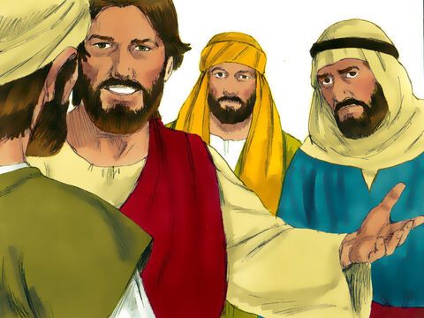
Miraculous Bread - John 6:5
When Jesus then lifted up his eyes, and saw a great company come unto him, he saith unto Philip, Whence shall we buy bread, that these may eat?

Slide 37
Miraculous Bread - John 6:6
And this he said to prove him: for he himself knew what he would do.

Slide 38
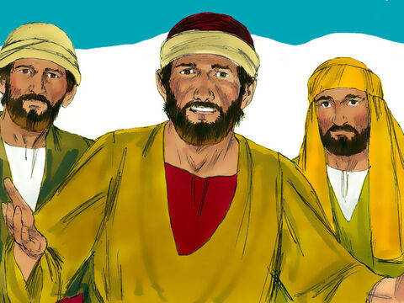
Miraculous Bread - John 6:7
Philip answered him, Two hundred pennyworth of bread is not sufficient for them, that every one of them may take a little.

Slide 39
He who taught the people the way to secure peace and happiness was just as thoughtful of their temporal necessities as of their spiritual need. The people were weary and faint. There were mothers with babes in their arms, and little children clinging to their skirts.
The Desire of Ages, p. 365

Slide 40
Miraculous Bread - John 6:8
One of his disciples, Andrew, Simon Peter's brother, saith unto him,

Slide 41
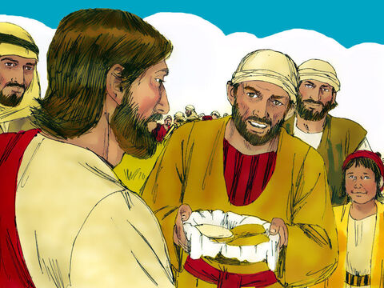
Miraculous Bread - John 6:9
There is a lad here, which hath five barley loaves, and two small fishes: but what are they among so many?

Slide 42
Many had been standing for hours. They had been so intensely interested in Christ's words that they had not once thought of sitting down, and the crowd was so great that there was danger of their trampling on one another.
The Desire of Ages, p. 365

Slide 43
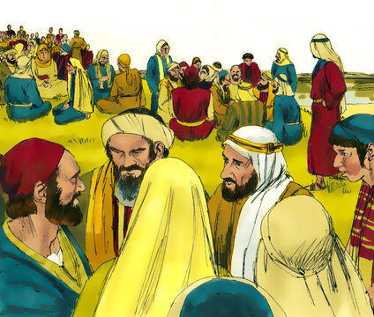
Miraculous Bread - John 6:10
And Jesus said, Make the men sit down. Now there was much grass in the place. So the men sat down, in number about five thousand.

Slide 44
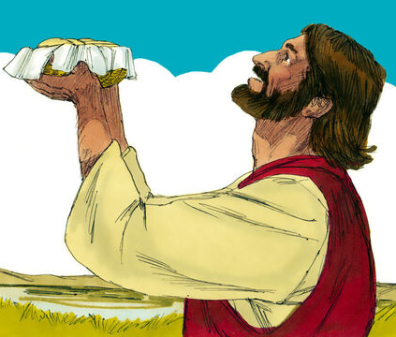
Miraculous Bread - John 6:11
And Jesus took the loaves; and when he had given thanks, he distributed to the disciples, and the disciples to them that were set down; and likewise of the fishes as much as they would.

Slide 45
Christ could have spread before the people a rich repast, but food prepared merely for the gratification of appetite would have conveyed no lesson for their good. Christ taught them in this lesson that the natural provisions of God for man had been perverted.
The Desire of Ages, p. 366

Slide 46
And never did people enjoy the luxurious feasts prepared for the gratification of perverted taste as this people enjoyed the rest and the simple food which Christ provided so far from human habitations.
The Desire of Ages, p. 366

Slide 47
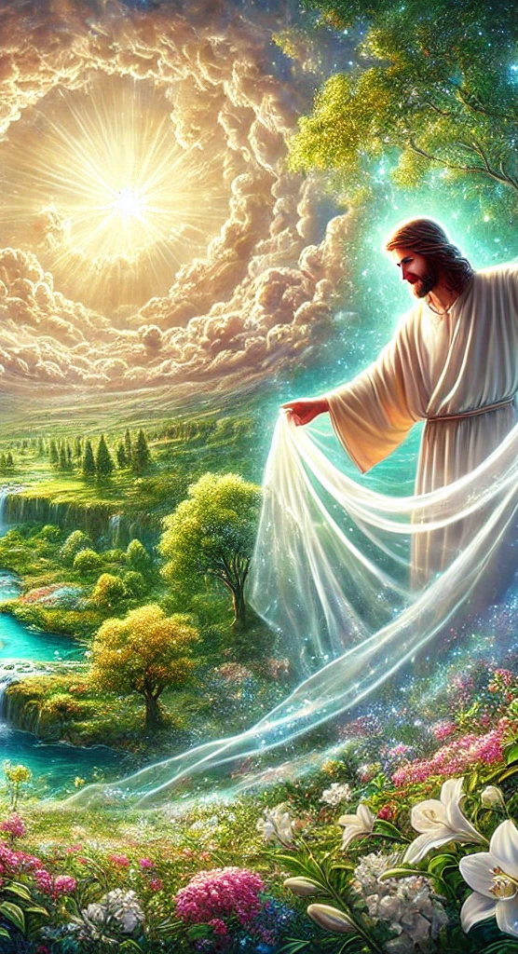
In feeding the five thousand, Jesus lifts the veil from the world of nature, and reveals the power that is constantly exercised for our good. In the production of earth's harvests God is working a miracle every day. It is God who is every day feeding millions from earth's harvest fields.
DA 367

Slide 48
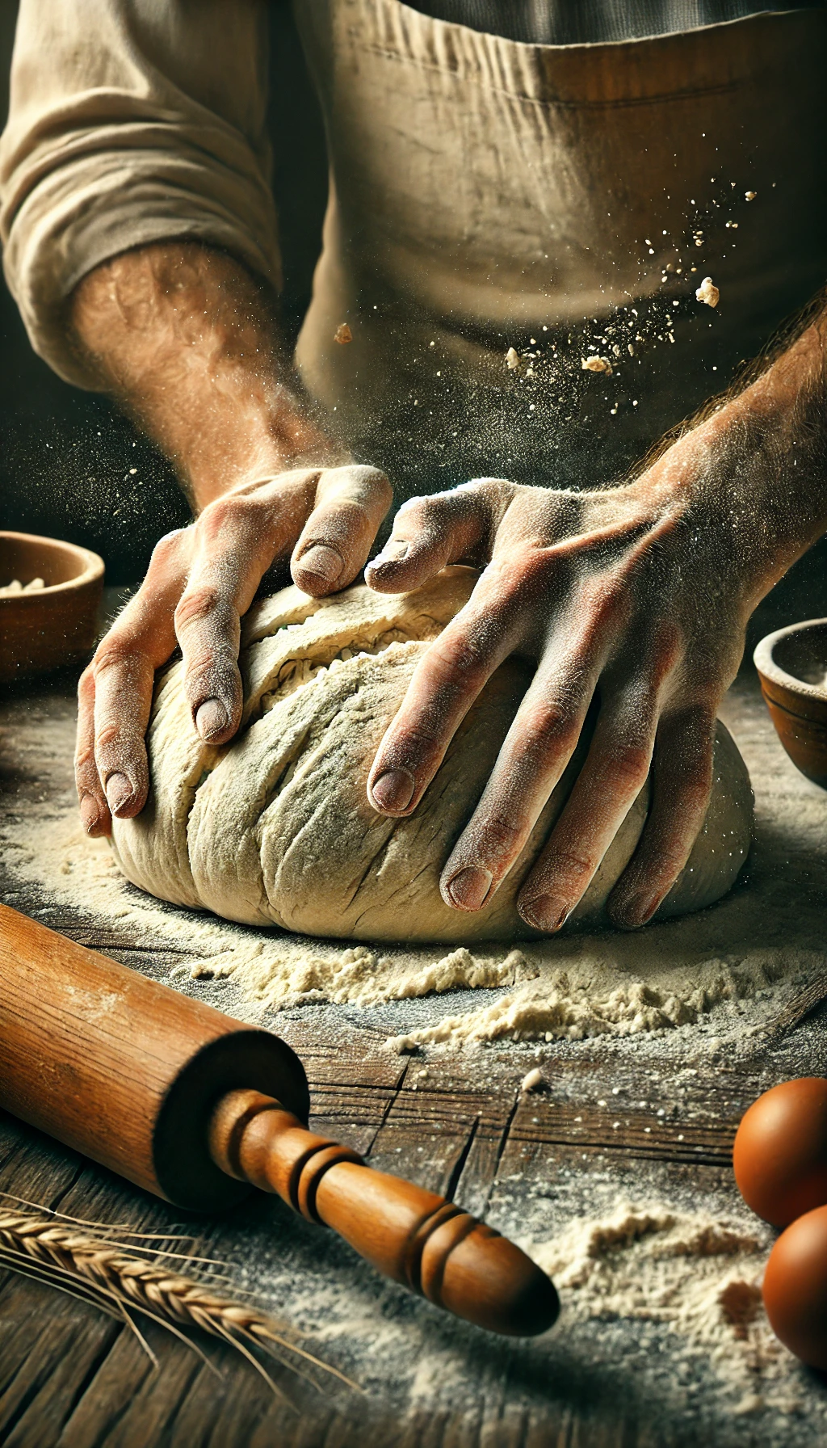
Men are called upon to co-operate with God in the care of the grain and the preparation of the loaf, and because of this they lose sight of the divine agency. They do not give God the glory due unto His holy name. The working of His power is ascribed to natural causes or to human instrumentality.
DA 367

Slide 49

Man is glorified in place of God, and His gracious gifts are perverted to selfish uses, and made a curse instead of a blessing. God is seeking to change all this. He desires that our dull senses shall be quickened to discern His merciful kindness and to glorify Him for the working of His power.
DA 367

Slide 50
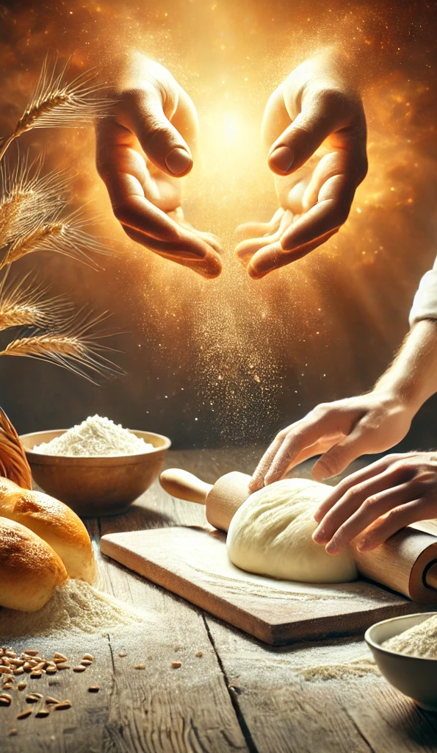
He desires us to recognize Him in His gifts, that they may be, as He intended, a blessing to us. It was to accomplish this purpose that the miracles of Christ were performed.
DA 367

Slide 51
After the multitude had been fed, there was an abundance of food left. But He who had all the resources of infinite power at His command said, “Gather up the fragments that remain, that nothing be lost.”
The Desire of Ages, p. 367

Slide 52
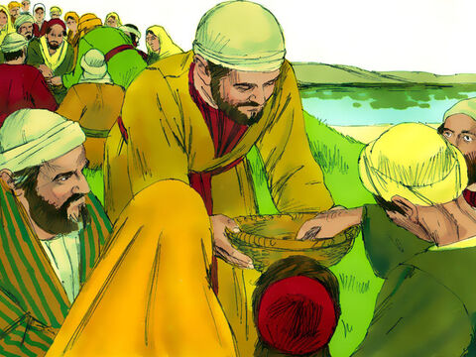
Miraculous Bread - John 6:12
When they were filled, he said unto his disciples, Gather up the fragments that remain, that nothing be lost.

Slide 53
These words meant more than putting the bread into the baskets. The lesson was twofold. Nothing is to be wasted. We are to let slip no temporal advantage. We should neglect nothing that will tend to benefit a human being. Let everything be gathered up that will relieve the necessity of earth's hungry ones.
The Desire of Ages, p. 367

Slide 54
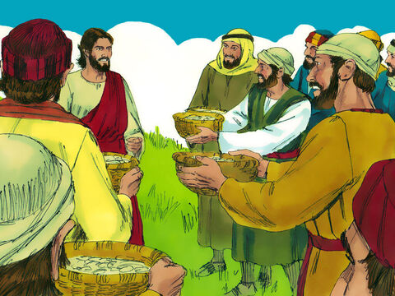
Miraculous Bread - John 6:13
Therefore they gathered them together, and filled twelve baskets with the fragments of the five barley loaves, which remained over and above unto them that had eaten.

Slide 55
And there should be the same carefulness in spiritual things. When the baskets of fragments were collected, the people thought of their friends at home. They wanted them to share in the bread that Christ had blessed. The contents of the baskets were distributed among the eager throng, and were carried away into all the region round about.
The Desire of Ages, p. 368

Slide 56
So those who were at the feast were to give to others the bread that comes down from heaven, to satisfy the hunger of the soul. They were to repeat what they had learned of the wonderful things of God. Nothing was to be lost. Not one word that concerned their eternal salvation was to fall useless to the ground.
The Desire of Ages, p. 368

Slide 57
“The word of God is the seed. Every seed has in itself a germinating principle.”
- Desire of Ages, p. 76

Slide 58
Life and Bread- John 10:10
10 The thief cometh not, but for to steal, and to kill, and to destroy: I am come that they might have life, and that they might have it more abundantly.

Slide 59
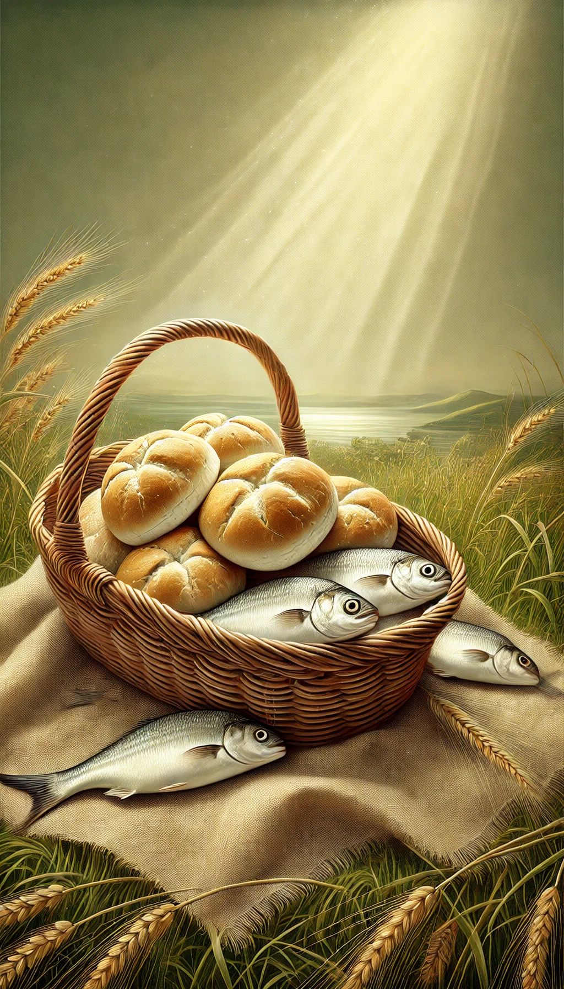
The miracle of the loaves teaches a lesson of dependence upon God. When Christ fed the five thousand, the food was not nigh at hand. Apparently He had no means at His command. Here He was, with five thousand men, besides women and children, in the wilderness.
DA 368

Slide 60
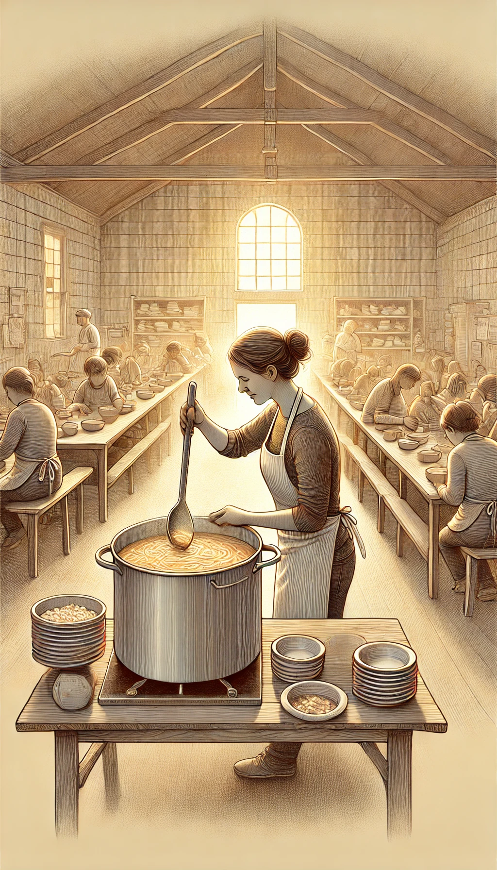
And when we are brought into strait places, we are to depend on God. We are to exercise wisdom and judgment in every action of life, that we may not, by reckless movements, place ourselves in trial. We are not to plunge into difficulties, neglecting the means God has provided, and misusing the faculties He has given us.
DA 369

Slide 61

Christ's workers are to obey His instructions implicitly. The work is God's, and if we would bless others His plans must be followed. Self cannot be made a center; self can receive no honor. If we plan according to our own ideas, the Lord will leave us to our own mistakes.
DA 369

Slide 62
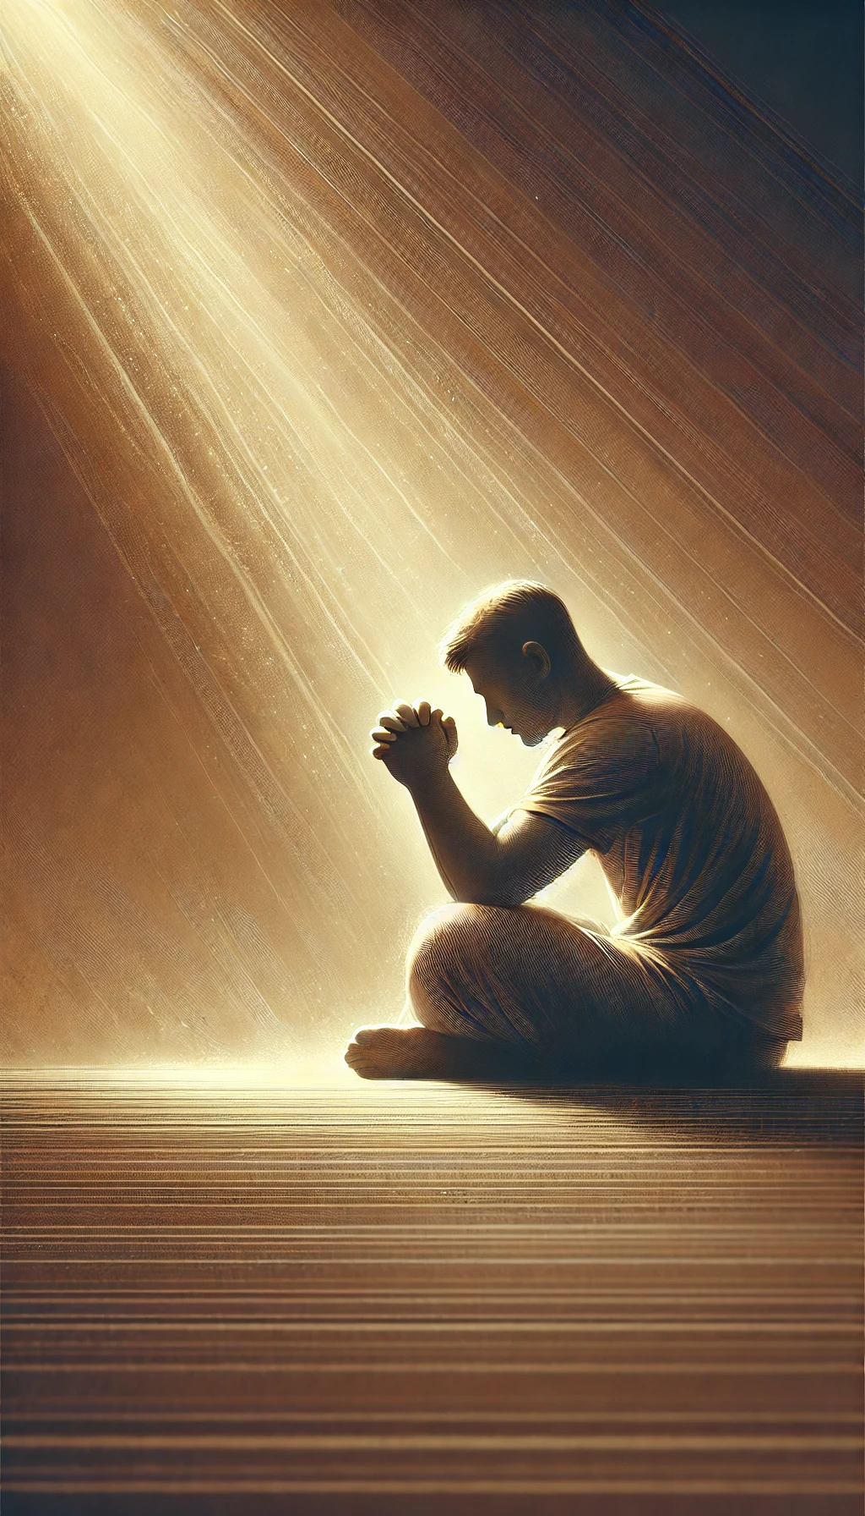
But when, after following His directions, we are brought into strait places, He will deliver us. We are not to give up in discouragement, but in every emergency we are to seek help from Him who has infinite resources at His command.
DA 369

Slide 63

Bread to the World- Mark 16:15
15 And he said unto them, Go ye into all the world, and preach the gospel to every creature.

Slide 64

Bread to the World- Isaiah 58:6-14
6 Is not this the fast that I have chosen? to loose the bands of wickedness, to undo the heavy burdens, and to let the oppressed go free, and that ye break every yoke?

Slide 65
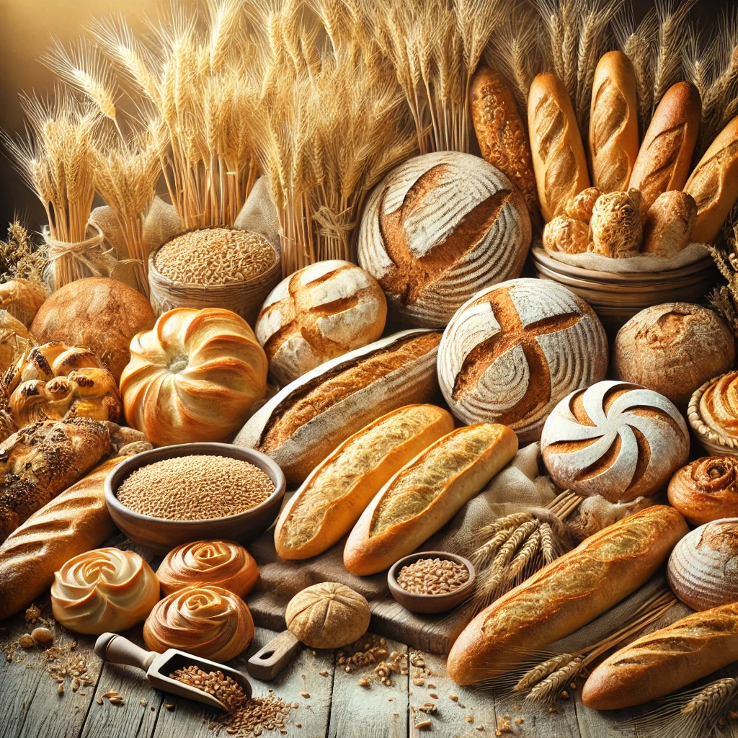
Bread to the World- Isaiah 58:7-14
7 Is it not to deal thy bread to the hungry, and that thou bring the poor that are cast out to thy house? when thou seest the naked, that thou cover him; and that thou hide not thyself from thine own flesh?

Slide 66

Bread to the World- Isaiah 58:8-14
8 Then shall thy light break forth as the morning, and thine health shall spring forth speedily: and thy righteousness shall go before thee; the glory of the Lord shall be thy reward.

Slide 67

Bread to the World- Isaiah 58:9-14
9 Then shalt thou call, and the Lord shall answer; thou shalt cry, and he shall say, Here I am. If thou take away from the midst of thee the yoke, the putting forth of the finger, and speaking vanity;

Slide 68

Bread to the World- Isaiah 58:10-14
10 And if thou draw out thy soul to the hungry, and satisfy the afflicted soul; then shall thy light rise in obscurity, and thy darkness be as the noon day:

Slide 69

Bread to the World- Isaiah 58:11-14
11 And the Lord shall guide thee continually, and satisfy thy soul in drought, and make fat thy bones: and thou shalt be like a watered garden, and like a spring of water, whose waters fail not.

Slide 70
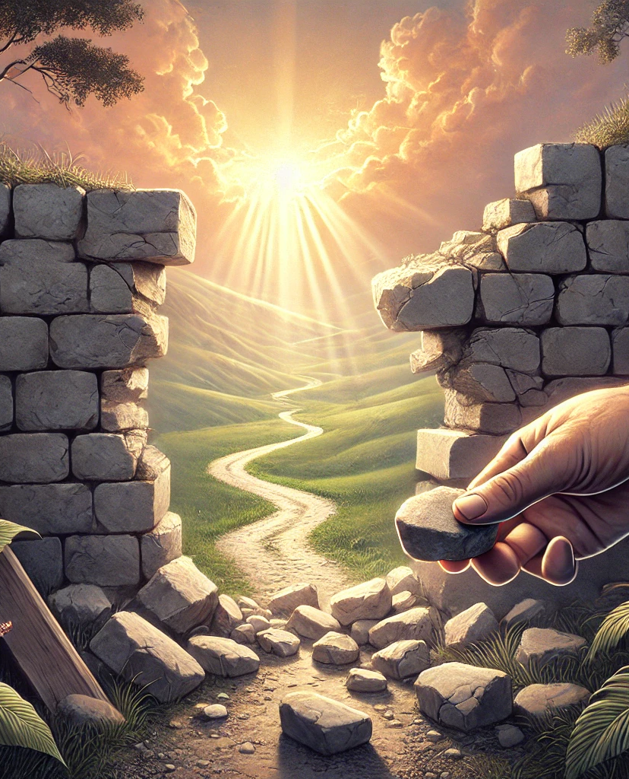
Bread to the World- Isaiah 58:12-14
12 And they that shall be of thee shall build the old waste places: thou shalt raise up the foundations of many generations; and thou shalt be called, The repairer of the breach, The restorer of paths to dwell in.

Slide 71
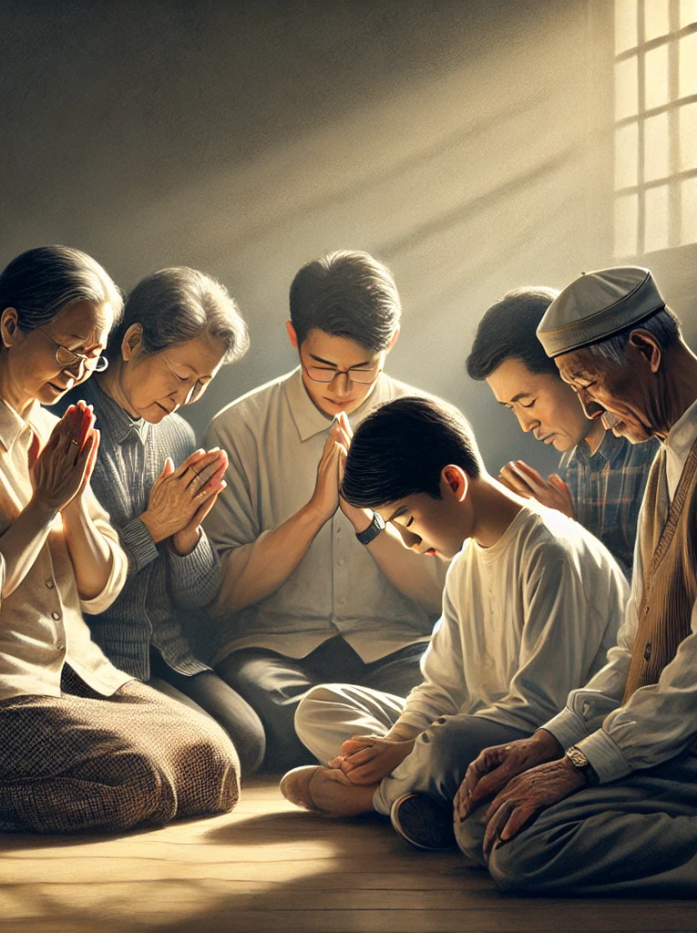
Bread to the World- Isaiah 58:13-14
13 If thou turn away thy foot from the sabbath, from doing thy pleasure on my holy day; and call the sabbath a delight, the holy of the Lord, honourable; and shalt honour him, not doing thine own ways, nor finding thine own pleasure, nor speaking thine own words:

Slide 72

Bread to the World- Isaiah 58:14
14 Then shalt thou delight thyself in the Lord; and I will cause thee to ride upon the high places of the earth, and feed thee with the heritage of Jacob thy father: for the mouth of the Lord hath spoken it.

Slide 73
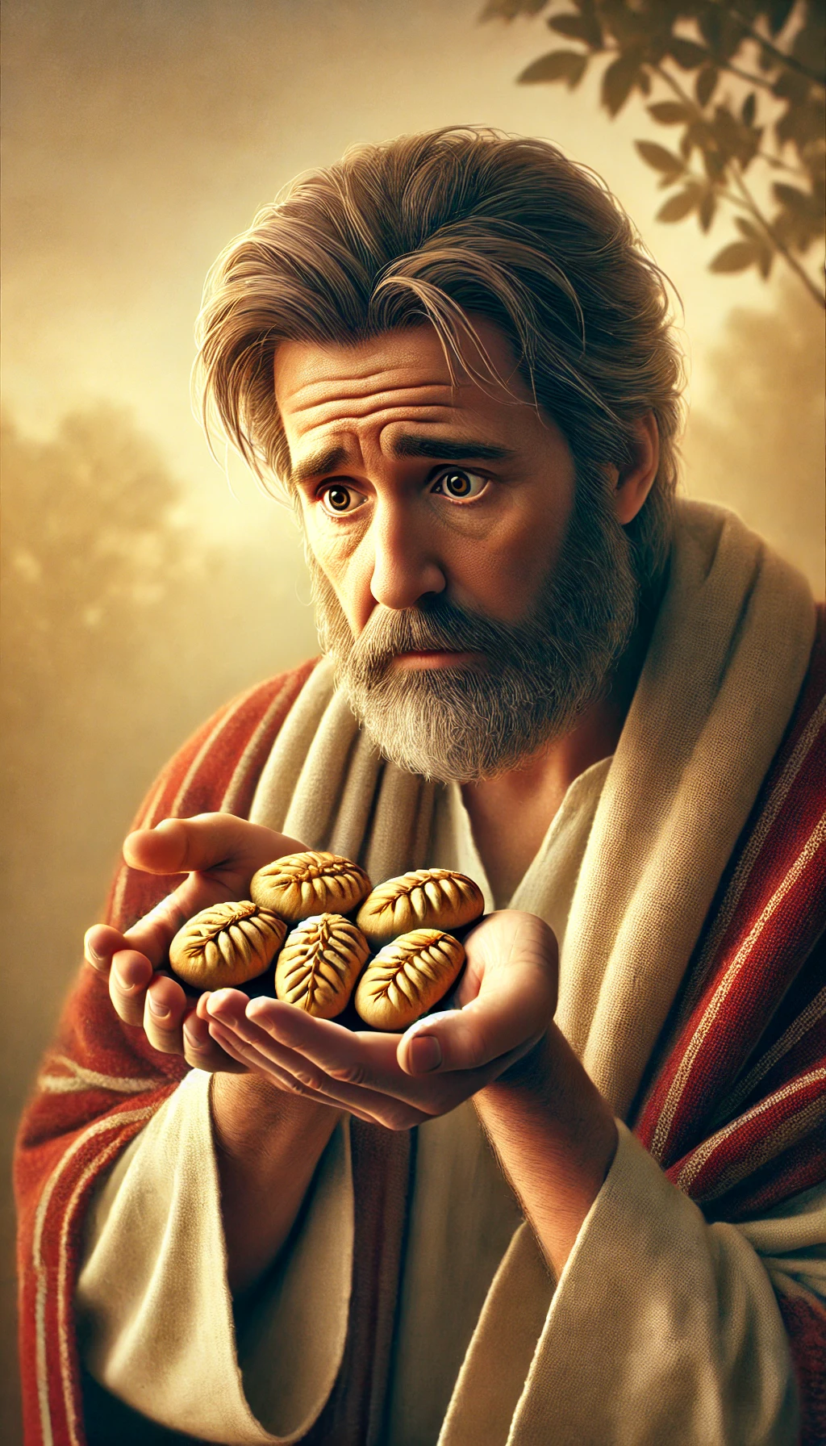
But how often our hearts sink, and faith fails us, as we see how great is the need, and how small the means in our hands. Like Andrew looking upon the five barley loaves and the two little fishes, we exclaim, “What are they among so many?”
DA 369

Slide 74
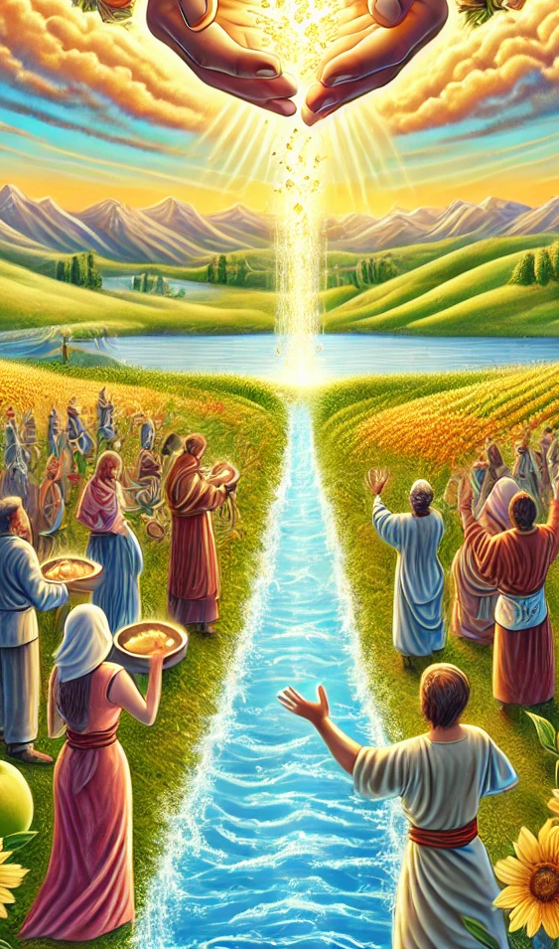
Often we hesitate, unwilling to give all that we have, fearing to spend and to be spent for others. But Jesus has bidden us, “Give ye them to eat.” His command is a promise; and behind it is the same power that fed the multitude beside the sea.
DA 369

Slide 75

In Christ's act of supplying the temporal necessities of a hungry multitude is wrapped up a deep spiritual lesson for all His workers. Christ received from the Father; He imparted to the disciples; they imparted to the multitude; and the people to one another.
DA 369

Slide 76
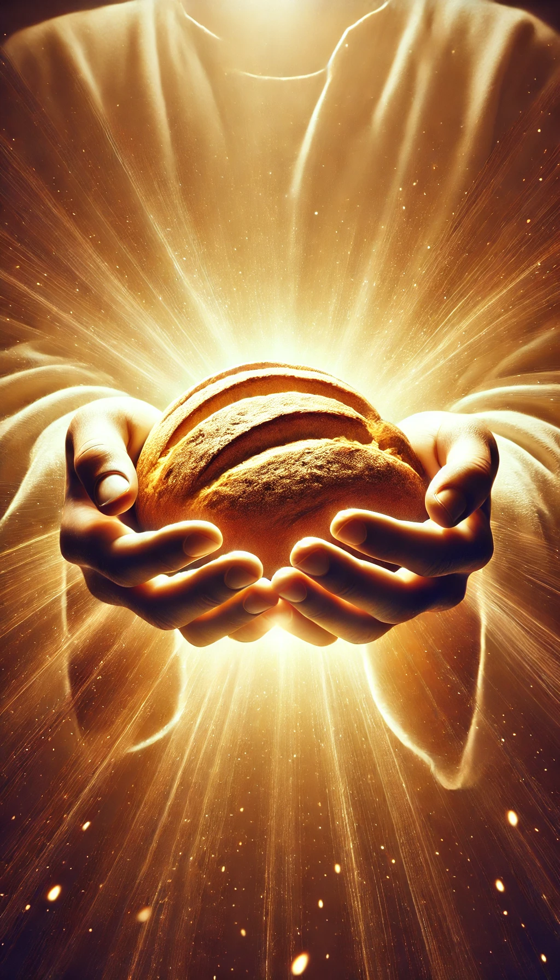
So all who are united to Christ will receive from Him the bread of life, the heavenly food, and impart it to others. I
n full reliance upon God, Jesus took the small store of loaves; and although there was but a small portion for His own family of disciples,
DA 369

Slide 77

He did not invite them to eat, but began to distribute to them, bidding them serve the people. The food multiplied in His hands; and the hands of the disciples, reaching out to Christ Himself the Bread of Life, were never empty. The little store was sufficient for all.
DA 369

Slide 78
The Desire of Ages, p. 250
“There is no limit to the usefulness of one who, by putting self aside, makes room for the working of the Holy Spirit upon his heart, and lives a life wholly consecrated to God. If men will endure the necessary discipline, without complaining or fainting by the way, God will teach them hour by hour, and day by day. He longs to reveal His grace.”

Slide 79
The Desire of Ages, p. 251
God takes men as they are, and educates them for His service, if they will yield themselves to Him…Continual devotion establishes so close a relation between Jesus and His disciple that the Christian becomes like Him in mind and character…. He who longs to be of service to Christ is so quickened by the life-giving power of the Sun of Righteousness that he is enabled to bear much fruit to the glory of God.

Slide 80
“Every true disciple is born into the kingdom of God as a missionary.”
- Desire of Ages, p. 195

